Slide 1

MAJOR PROJECT SOLVING MATHS WORD PROBLEMS USING AI
Group 22
Under the Supervision of Dr. Waseem Ahmed
DEBAL HUSSAIN ABBAS(18BCS046), MAUWAZ AHMED FAROOQUI(18BCS048)
DEPARTMENT OF COMPUTER ENGINEERING, JAMIA MILLIA ISLAMIA UNIVERSITY

Slide 2
INTRODUCTION
In recent years, large language models have demonstrated impressive skills across many diverse tasks. However, even the largest models falter when required to perform multi-step mathematical reasoning. Model samples frequently contain catastrophic mistakes, even after the model has been appropriately fine-tuned. Mathematical reasoning thus reveals a critical weakness in modern language models.

Slide 3
ABOUT THE PROBLEM
State-of-the-art language models can match human performance on many tasks, but they still struggle to robustly perform multi-step mathematical reasoning. To diagnose the failures of current models and support research, we use GSM8K, a dataset of 8.5K high quality linguistically diverse grade school maths word problems. We find that even the largest transformer models fail to achieve high test performance, despite the conceptual simplicity of this problem distribution.

Slide 4
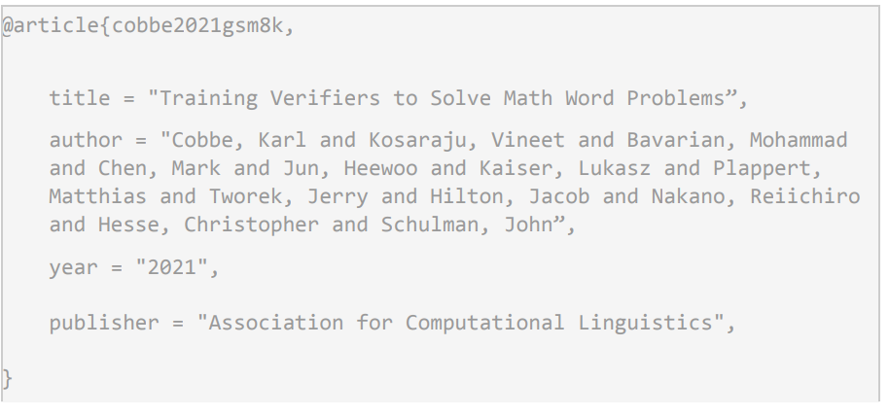
THE RESEARCH PAPER

Slide 5
Large language models like GPT-3 have many impressive skills, including their ability to imitate many writing styles, and their extensive factual knowledge.
However, they struggle to perform tasks that require accurate multistep reasoning, like solving grade school mathematics word problems. Although the model can mimic the pattern of correct solutions, it regularly produces critical errors in logic.
To tackle this issue and reduce the errors in logic we propose to solve the problem in the following way

Slide 6
METHODOLOGY
Weng earns $12 an hour for babysitting. Yesterday, she just did 50 minutes of babysitting. How much did she earn?
We propose to solve the above problem by dividing it into two subtasks -
Sub-Task 1
To create sub-questions from the given question
Sub Question Generator
How much does Weng earn per minute?
How much did Weng earn?

Slide 7
question:How many clips did Natalia sell altogether in April and May? context:Natalia sold clips to 48 of her friends in April, and then she sold half as many clips in May. How many clips did Natalia sell altogether in April and May? Natalia sold 48/2 = 24 clips in May.
Sub-Task 2
Trying to solve each sub-question using the main question and answers of previous sub questions as the context (source of information)
Solver
Natalia sold 48+24 = <<48+24=72>>72 clips altogether in April and May.

Slide 8
Original Question
SubQuestion 1
Answer 1
The Architecture of our
Methodology
SubQuestion 2
Answer 2
(n-2) sub questions
SubQuestion n
Final Answer

Slide 9
ABOUT THE DATASET
GSM8K consists of 8.5K high quality grade school maths word problems. Each problem takes between 2 and 8 steps to solve, and solutions primarily involve performing a sequence of elementary calculations using basic arithmetic operations (+ − × ÷) to reach the final answer. Fine-tuned state-of-the-art language models perform poorly on this dataset, primarily due to the high diversity of problems. At the same time, GSM8K solutions depend only on elementary concepts, so achieving high test performance is an achievable goal. Solutions in GSM8K are written as natural language rather than as pure maths expressions. By sticking to natural language, model-generated solutions are more readily interpretable by humans

Slide 10
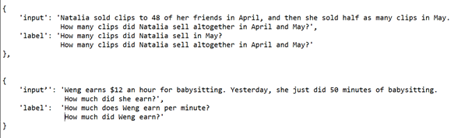
Dataset Used for SubTask 1

Slide 11
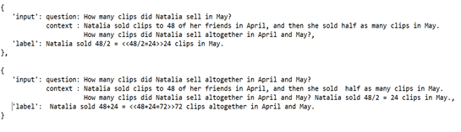
Dataset Used for SubTask 2

Slide 12
How do we derive the Dataset for SubTask-2 ?
In the Dataset used for Subtask 2, we use calculator annotations, and question and context keys
Calculator Annotations: We use these annotations to take away the task of performing the arithmetic calculations from the model and perform them using a simple function defined by us.Example of such annotations <<48/2=24>>.
Question and Context keys: We use these keys in our dataset as they have been used previously in similar tasks and lead to higher accuracy by aligning the texts correspondingly. And helps model to identify what it needs to answer and where to find the information for.

Slide 13
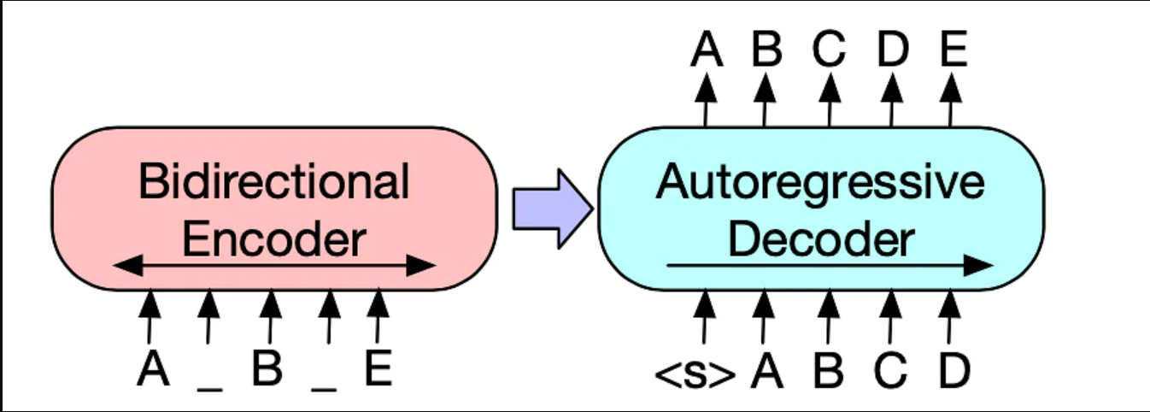
BART ENCODER-DECODER MODEL
Bart uses a standard seq2seq/machine translation architecture with a bidirectional encoder (like BERT) and a left-to-right decoder (like GPT).
BART is particularly effective when fine tuned for text generation but also works well for comprehension tasks.

Slide 14
TRAINING MBART
We have used HuggingFace MBart-50 which is an Encoder-Decoder architecture based transformer model. MBart-50 is created using the original mbart-large-cc25 checkpoint by extending its embedding layers with randomly initialized vectors for an extra set of 25 language tokens and then pretrained on 50 languages.

Slide 15
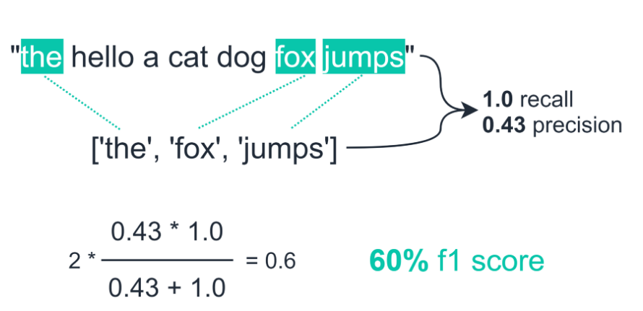
EVALUATION METRIC - ROUGE Score
ROUGE-N measures the number of matching ‘n-grams’ between our model-generated text and a ‘reference’. For ROUGE-1 and ROUGE-2 we would be measuring the match-rate of unigrams and bigrams between our model output and reference. F1-score gives us a reliable measure of our model performance that relies on both precision and recall.
ROUGE-L measures the longest common subsequence (LCS) between our model output and reference.
Model output
Reference

Slide 16
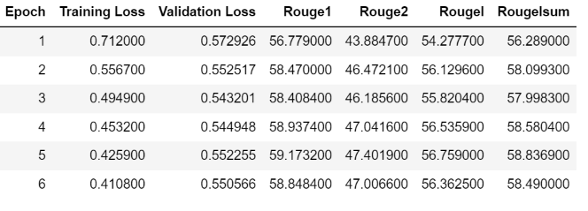
SUBTASK-1 EVALUATION
We trained the model for Subtask-1 for 6 epochs with batch size of 4
Following are the results. We have used Rogue Score as our metric to evaluate how good are the sequences generated.

Slide 17
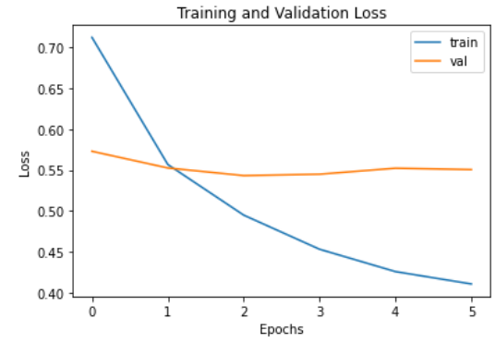
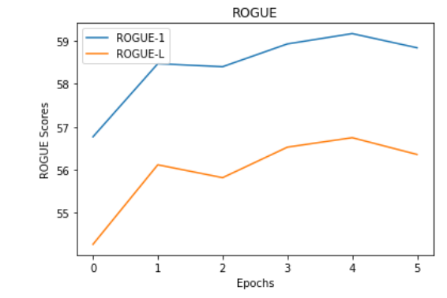
Evaluation

Slide 18
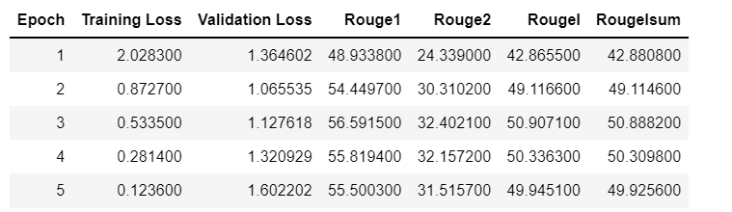
SUBTASK-2 EVALUATION
We trained the model for 5 epochs for a batch size of 4 and the results are as follows:
And we use the best checkpoint having the highest ROGUE-L score from the following checkpoints.

Slide 19
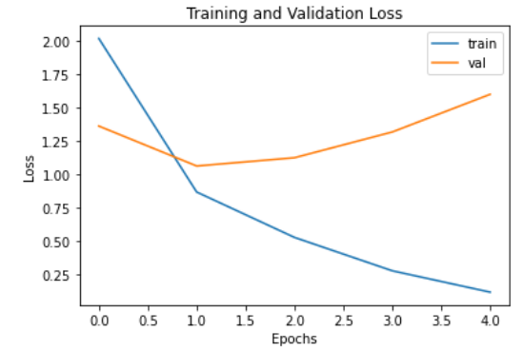
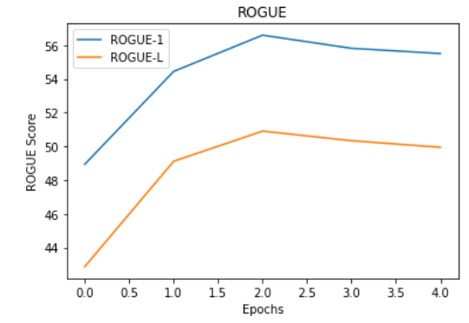

Slide 20
RESULTS AND ANALYSIS
We have tried to evaluate our methodology against the one described in the paper under the same environment, so we trained another model as described in the paper but due to limited computation resources we have used a distilled version of that model, which is 10 times smaller but is also comparable in size to the model used by us.

Slide 21
We have also evaluated our approach against a new methodology proposed by Google Research, Brain Team in the paper Self-Consistency Improves Chain of Thought Reasoning in Language Models which has been released on 6 April 2022. The accuracies achieved by us are not the same as achieved in the papers, due to the difference in the scale of the models used by us and the one mentioned in the papers.
But as describe in the paper “Unsurprisingly, we see that the 175B model significantly outperforms the smaller models. Assuming a log-linear trend, we can naively extrapolate these results to estimate that a model with 10¹⁶ parameters would be required to reach an 80% solve rate, when using the full GSM8K training set”.

Slide 22
Methodology | Number of Parameters | Accuracy
Our Method (mBART) | 535M | 8.5%
OpenAI (GPT-2) | 350M | 3.9%
Google (GPT-2) | 350M | 2.8%
Open AI (GPT-3) | 6B | 20%
Open AI (GPT-3) | 175B | 55%
Google (LaMDA) | 137B | 27.7%
Google (PaLM) | 540B | 74.4%

Slide 23
From the Table in the previous slide, we see that accuracy increases with increase in the number of parameters. Due to the limits of computation and memory, we could only train our model with 535 million parameters but achieved a considerable boost in accuracy as compared to OpenAI GPT-2 model with 350 million parameters.
Google’s PaLM and LaMDA are the latest models trained on GSM8K dataset with 540 billion and 137 billion parameters respectively. They have achieved 27.7% and 74.4% accuracies respectively.
So as described above assuming a log-linear trend between the accuracy and number of parameters in the model we can extrapolate that our methodology will perform at par with the methods above.

Slide 24
CONCLUSION
We have seen that instead of asking the model to solve the entire question at once, breaking down the problem into sub-questions and then solving them provides a significant performance boost relative to a fine-tuning baseline.
We have trained our model within the scope of memory size and computation available. We have compared our results with models trained with more number of parameters on greater memory and computation architecture. We have shown that our proposed method will perform at par with other methods if we increase the number of parameters and computation memory.

Slide 25
REFERENCES
1. Cobbe, K., Kosaraju, V., Bavarian, M., Hilton, J., Nakano, R., Hesse, C., & Schulman, J. (2021). Training verifiers to solve math word problems. arXiv preprint arXiv:2110.14168.
2. OpenAI Blog- Solving Math Word Problems (openai.com)
3. Dataset - github.com/openai/grade-school-math/grade_school_math/data
4. Devlin, Jacob, et al. "Bert: Pre-training of deep bidirectional transformers for language understanding." arXiv preprint arXiv:1810.04805 (2018).
5. Yibin, Yao, et al. "Accuracy assessment and analysis for GPT2." Acta Geodaetica et Cartographica Sinica 44.7 (2015): 726.
6. ROUGE Score - Measure NLP Accuracy With ROUGE | Towards Data Science
7. Transformers BART Model Explained for Text Summarization (projectpro.io)
8. MBart and MBart-50 (huggingface.co)
9. A. Amini et. al. Mathqa: Towards interpretable math word problem solving with operation based formalisms. arXiv preprint arXiv:1905.13319, 2019.
10. T. B. Brown et al. Language models are few-shot learners. arXiv preprint arXiv:2005.14165, 2020.
11. Wei, J., Wang, X., Schuurmans, D., Bosma, M., Chi, E., Le, Q., & Zhou, D. (2022). Chain of thought prompting elicits reasoning in large language models. arXiv preprint arXiv:2201.11903.

Slide 26
THANK YOU

